Slide 1

软件工程专业英语
计算机科学学院
School of Computer Science
Simulated Writing: E-mail

Slide 2
Overview
E-mail is an electronic, computer-assisted online communication tool. It can transmit various types of correspondence:
simple message
memos and letters
complex reports
tables of data
graphs and charts
documents with limited size
…, …

Slide 3
Advantages provided by E-mail
simplicity
convenience
speed
low cost
E-mail when your message is
brief
informal
sent to a number of people
timely
urgent

Slide 4
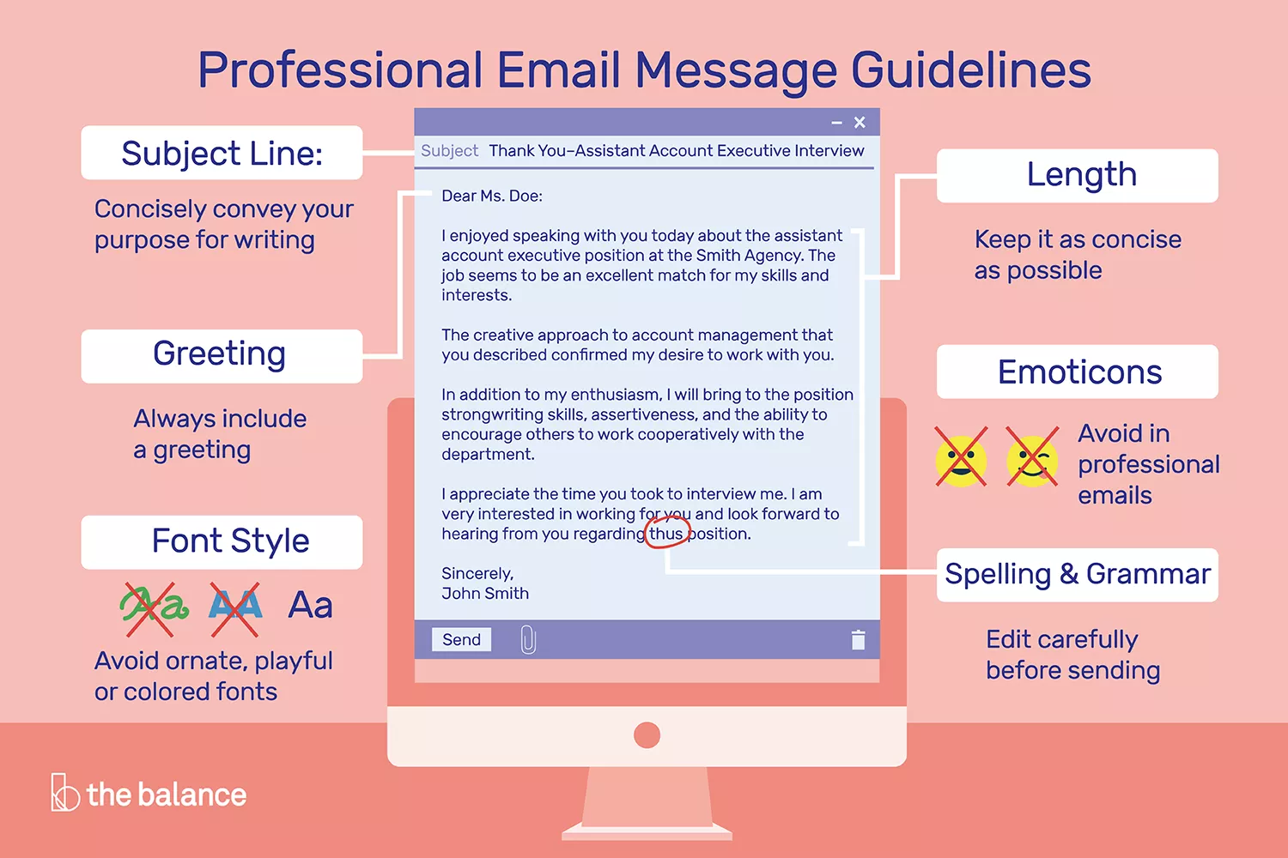
Professional Email Message Guidelines
https://www.thebalancecareers.com/how-to-write-and-send-professional-email-messages-2061892
Illustration by Melissa Ling. © The Balance, 2018
Notes:
ornate: 华美的，富丽的

Slide 5
Subject Line
The subject line should concisely convey your purpose for writing. Your subject line can be as simple as "Thank You" or "Request for Recommendation."
Greeting
Even if you are writing a very short email, include a greeting. If you know the name of the person, include it. Unless you are on a first-name basis with the person, call them by their title.
Length
Keep your email as concise as possible. People tend to skim long emails, so only include essential information.

Slide 6
Font Style
Avoid ornate, playful, or colored fonts; these simply distract the recipient from your actual message.﻿ Avoid overusing bold and italics as well, which make an email look cluttered. Do not write in all capital letters either; this comes across as angry or overexcited in an email.
Emoticons
Do not include emoticons in a professional email; save these for personal correspondence.

Slide 7
Spelling and Grammar
Just because you are writing an email does not mean you should be sloppy about spelling and grammar. Edit your email carefully before sending it. An error-free message tells the recipient that your email should be taken seriously.
Closing
Sign off with a brief "Thank you," "Best," or another simple send-off, and then your name. Most email accounts let you embed a signature with your name, title, and contact information into every email. It is a terrific way to make each correspondence more professional.

Slide 8
Additional Tips
Make Sure Your Message is Complete
Double-check to make sure the subject line of your email is filled in, you have included a signature, you are sending the message to the right contact person, and you have filled in the Bcc field to send a copy to yourself, so you have a record of the email message.
Proof Your Email Message
Before you hit send, also make sure you spell-check and check your grammar and capitalization. They are just as important in email correspondence as they are in a paper letter.

Slide 9
Additional Tips
Send a Test Email Message
Before you actually send your email, send the message to yourself first to check that the formatting works and that nothing looks out of place. If everything looks good, go ahead and send the email to the company or individual you’re contacting.
Send a Copy of the Email Message to Yourself
Use the Bcc field to send a copy of the email message to yourself, so you have a record of when you sent the message and who you sent it to.﻿ You can also find this information in your sent folder.
File Your Copies
With many email programs you can set up folders to make it easier to find any important past emails. Set up folders for all your job search emails and other professional emails and file your copies after you send your messages.

Slide 10
Useful Phrases
https://blog.talaera.com/business-emails-phrases
(1) Opening Lines
Opening greeting to one person
Dear Mr/ Ms/ Dr/ Professor + family name (= Dear Mr./ Ms./ Dr./ Prof + family name)
Dear Alex
Hi (John)
Dear Sir or Madam
Opening greeting to more than one person
Dear all
Hi (everyone/ guys)
To: All faculty members/ To: New recruits/ To: All members/ To:…

Slide 11
(1) Opening Lines
Being social
By adding these at the beginning of your emails you will sound more friendly and social.
I hope you had a good weekend.
I hope you had a great trip.
Hope you had a nice break.
I hope you are well.
I hope all is well.
Hope you're enjoying your holiday.
I hope this email finds you well.
I hope you enjoyed the event.
I'm glad we had a chance to chat at the convention.
It was great to see you on Thursday.
It was a pleasure to meet you yesterday.
Notes:
Thank you for your email (yesterday/ of 12 May) about…
Thanks for your email this morning/ earlier/ yesterday/ on Monday/ last week/…
Thanks for your quick reply./ Thanks for getting back to me so quickly.
Thanks for your phone call this morning/ the information about/ your interest in/ your help with/ your hospitality in…/…
Thanks for sending me/ for contacting me about/ for attending/ asking us about/ informing us/ giving us feedback on/ inviting me to/ talking to me about…
It was great/ so nice to see you again on Monday.
(I) just read your email about/ (I) just got your message about/ (I) just got your request for…
It was a pleasure/ my great pleasure to meet you last week.
Sorry for my late reply/ Sorry it took me so long to get back to you/ Sorry not to reply sooner (but/ but I had to…).
Thank you for finding the time to meet me/ talk to me/ attend…
Sorry it’s been so long since I was last in touch/ since my last email.

Slide 12
(1) Opening Lines
Emailing first
I am writing to you about our last meeting/your presentation yesterday/our next event.
I am writing to you with regards to/regarding/concerning/in connection with...
I am writing to ask/enquire/let you know/confirm/check/invite you to/to update you on/ask for a favor...
I am writing you to follow up on...
I am contacting you to inform...
I am reaching out because...
This is just a quick note to...
This is just a quick reminder...
I wanted to let you know that...
Might I take a moment of your time to... (very formal)
It's [Your Name] from [Your Company].
This email is just to let you know that...

Slide 13
(1) Opening Lines
Replying
I just got your request for...
I just read your email about...
As we discussed, I would like to send you...
Thank you for your email about...
Thanks for your email this morning/yesterday/on Wednesday/last month...
Thanks for your feedback on/your invitation/your suggestion
Thanks for sending/asking about/attending
Thanks for your quick reply.
Thanks for getting back to me so quickly.
Thank you for reaching out (to me).

Slide 14
(1) Opening Lines
Apologizing
Sorry for my late reply.
Sorry it took me so long to get back to you.
I apologize for the late response.
Sorry it’s been so long since my last email.
I was sorry to hear about...
Please accept our apologies for any inconvenience caused.

Slide 15
Useful Phrases
(2) Body Lines
Attachments and information
I’ve attached…
Please find [file] attached.
I'm enclosing [file].
Please see the information below for more details about...
The parts in bold/in red/in blue are my comments/are the changes we made.
Here's the document that you asked for,
I’ve attached [file] for your review.
I'm sending you [file] as a pdf file.
The attached file contains...
Could you please sign the attached form and send it back to us by [date]?
Here’s the [document] we discussed.
[file] is attached.
Please take a look at the attached file.
Take a look at the [file] I've attached to this email.
I've attached [file].
More information is available at www.website.com.
Please note that...

Slide 16
(2) Body Lines
Requests and enquiries
Could you please...?
Could you possibly tell me...?
Can you please fill out this form?
I'd really appreciate it if you could...
I'd be very grateful if you could...
It would be very helpful if you could send us/me...
I was wondering if you could/if you would be able to...
If possible, I'd like to know (more) about...
Please find my two main questions below.

Slide 17
(2) Body Lines
Asking for clarifications
I didn't/don't fully understand [something]. Could you please explain that again?
I didn't quite get your point about [something]. Could you be more specific?
Could you repeat what you said about...?
Could you give us some more details on...?
If you could please shed some light on this topic, I would really appreciate it.
Could you please clarify [something]?
Could you please clarify when you would like us to finish this?
When exactly are you expecting to have this feature?
Here are the details on...
Could you please clarify what you would like us to do about...?
If I understood you correctly, you would like me to...
What exactly do you mean by [something]?
Could you explain what you mean by [something]?
In other words, would you like us to...

Slide 18
(2) Body Lines
Sharing information
Use these helpful phrases when need to give or receive some information (or when you already did).
Thank you for letting me know.
Thank you for the heads up.
Thank you for the notice.
Please note...
Quick reminder...
Just a quick/friendly reminder that...
Thank you for sharing.
I'd like to inform you that...
Just a quick heads up -
Thanks for keeping me in the loop.
Please keep me informed/posted/updated/in the loop.

Slide 19
(2) Body Lines
Getting and giving approval
Please let me know if this is OK with you.
What are your thoughts (on this)?
What do you think?
Please let me know what you think.
We just need the thumbs up/the green light. (=we're waiting for approval)
You (totally) have the green light!
He approved of it, so you can go ahead with the project.

Slide 20
(2) Body Lines
Scheduling
I'd like to schedule a meeting on [day] if you are available/free then.
I am available on [day], if that's convenient for you.
Would you be available on [day]? If so, I'll send you an invite shortly.
Can you make it on [day]? If so, I'll book accordingly.
I'm afraid I can't make it on [day]. How about...?
(Due to...) I'm afraid we need to reschedule/delay/postpone/put back/cancel/call off/move/rearrange our meeting.
We are sorry to inform you that the interview/meeting scheduled for [day] will have to be rescheduled.

Slide 21
(2) Body Lines
Giving bad news
Unfortunately, ...
Unfortunately, we cannot/we are unable to ...
I'm afraid it will not be possible to...
Unfortunately, I have to tell you that...
I'm afraid that we can't...
We regret to inform you that...
I regret to inform you that (due to...) ...
After careful consideration we have decided (not) to ...
Due to [reason], it won't be possible to...
It's against company policy to...
I tried my best, but...
Despite my best efforts, ...
I can't see how...
I'm sorry but it's out of my hands.
I'm afraid I won't be able to...
I'm sorry to tell you that...

Slide 22
Useful Phrases
(3) Closing Lines
When something is expected
Looking forward to hearing from you soon.
I look forward to hearing from you soon.
Please let me know if this works/if you are available/if that sounds good/if you can/if you can help/if you need to reschedule...
I look forward to seeing/meeting you.
See you on Thursday/next week.
Thanks.
Thank you in advance.
Thank you for everything.
Cheers.
Any feedback you can give me on this would be greatly/highly/much appreciated.
If you could have it ready by tomorrow/the end of next week, I would really appreciate it.
I would appreciate your help in this matter.

Slide 23
(3) Closing Lines
Offering help or information
I hope you find this helpful.
I hope it's clearer now.
I hope that answers all your questions.
If we can be of any further assistance, please let us know.
Let me know if you need any help.
For further details...
If you have any (more) questions (about)...
In the meantime, if you need any more information,
I you need more information/more info/further information,
I know that's a lot to take in, so let me know if anything I've said doesn't make sense.
... please do not hesitate to contact me.
... please feel free to contact me/to get in touch.
... please let me know.
... drop me an email/drop me a line.

Slide 24
(3) Closing Lines
Apologizing (again!)
Thanks you for your understanding/for your patience.
Thanks again for your understanding/for your patience.
Once again, please accept our apologies for any inconvenience caused/for the inconvenience caused/for the delay/for the misunderstanding.
I hope this is okay with you.
I really hope we can find a solution soon.
I hope you can understand.
Sorry I couldn't be of more help.

Slide 25
(3) Closing Lines
Friendly ways to say 'bye'
Best regards,
All the best,
Best wishes,
Cheers,
Have a great weekend!
Have a wonderful day!

Slide 26
Frequently Used Abbreviations
Re: Re: is a commonly used abbreviation in the subject line of an email. It stands for “reply” or “response”. In most email applications being used, Re: is usually automatically added to the subject when the reply button is clicked.
Fwd or FW: Fwd or FW in a mail means “forward”. It is an email option that allows a sender to send or forward a received email to another recipient. Also, “FW” before the subject line of a mail denotes that it is a forwarded message.
CC & BCC: CC and BCC are also common abbreviations found in emails when trying to send a mail. CC stands for “Carbon Copy”. Mails are sent using this option when you send a copy of the same to more than one recipient and all of them are informed about it. BCC stands for “Blind Carbon Copy”. Mails that are sent using this option disable the recipients of the mail from being informed about the others receiving the same.
NRN: NRN is a formal acronym that is sent in mails. It stands for “No Reply Necessary”. It is usually used in work emails where the sender is trying to convey a one way message that does not require a reply.
EOM: EOM stands for “End of Message”. This is used for really quick and short messages that can be understood by reading the subject. The recipient does not need to open the mail as all the content is kept in the subject line.
TLTR: TLTR is an acronym used for times when you are running short on time and a long message is sent to you. It stands for “Too Long To Read” and indicates the sender that you need a brief summary of their mail.

Slide 27
HTH: HTH is typically used when responding to someone who is thanking you for some valuable help or guidance. It means “Hope That Helps”.
LET: LET refers to “Leaving Early Today”. It informs people, especially in a group message of an office or any other organization, that you are leaving early so that they reach out to you if they need anything.
PRB: PRB is written in time-sensitive mails. It stands for “Please Reply By” and requests the recipient to reply by a certain date or time to avoid late replies.
WFH: WFH stands for “Working From Home” and informs the recipient that you are working remotely that particular day.
TL;DR: TL;DR is usually written next to the summary of a massive mail. It stands for “Too Long; Didn’t Read. It might also be used by some people as a response to an email that is too long for them to invest their time in.
LMK: LMK is an informal way to end an email asking the recipient for their opinion. It stands for “Let Me Know”.
FYI: If you need to add a side-note to an email, use the abbreviation FYI meaning “For Your Information”.

Slide 28
TYT: TYT stands for “Take Your Time” and is used when you need a work done, but it is not urgent.
IDK: IDK is an informal abbreviation used in the body of a mail that stands for “I Don’t Know”.
SIM: SIM stands for “Subject Is Message” and this is also used for conveying messages quickly without having to open the mail. A short series of words is written after the abbreviation SIM in the subject mail.
NSFW: NSFW is used for emails that might be inappropriate and are “Not Safe For Work”.
TTYL: An informal way to say that you are busy at the moment and will have the conversation later. It stands for “Talk To You Later”.
SFW: SFW stands for “Safe For Work”. It is used for letting the recipient know that the mail safe to open, even though the file or article name may not seem appropriate.
OOO: OOO is a standard acronym used when you are not in the office and stands for “Out Of Office”.
Y/N: Y/N saves the recipient time by asking for only a “Yes or No” answer.
EOD: EOD stands for “End of Day”. It denotes that a mail or work will be sent or should be received before the day ends.

Slide 29
IMO: IMO is a down-to-earth way of sending a feedback mail when voicing your opinion. It stands for “In My Opinion”.
EOW: Similar to EOD, EOW denotes that a work shall be sent or should be received before the week ends and stands for “End of Week”.
BTW: BTW, which means “By The Way”, is usually used when there was something that you forgot to mention the last email.
FWIW: A humble way to give feedback on something. It denotes “For What It’s Worth”.
OT: OT stands for “Off Topic”. It is used in an email thread to indicate that the particular reply is in no way related to the topic at hand.
NONB: Used in the subject line, NONB meaning “Non-Business”, denotes that the sent mail is not related to work or business.
1L: 1L stands for “One Liner” which is used at the beginning of the subject to let the recipient know the entire message is in the subject line.
ASAP: Another informal abbreviation ASAP meaning “As Soon As Possible” that denotes the urgency of a feedback.

Slide 30
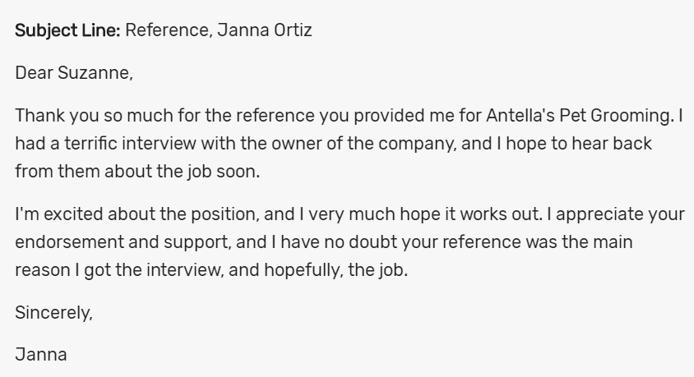
Samples

Slide 31
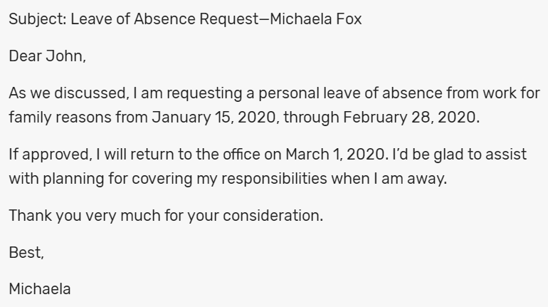

Slide 32
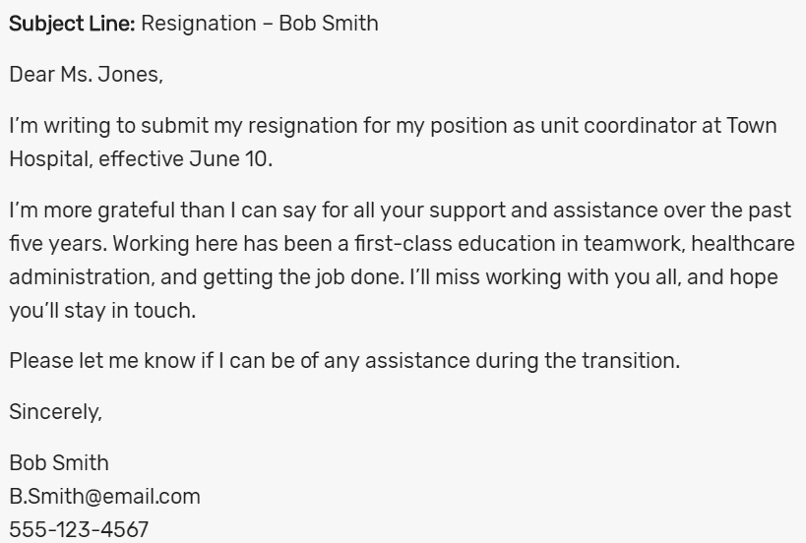

Slide 33
